Slide 1
intelliflo Innovate - Hackathon 2024
Explore new possibilities

Slide 2
Stock Analysis and Recommendation
Synergy
Ashish Gupta
Sandeep Kumar Singh
Sirisha Mangipudi

Slide 3
Overview
Problem Statement :
Forecasting stock market prices is a challenging task for analysts and researchers. Effective prediction systems assist traders by providing insights into future market trends. Given the abundance of fundamental and technical data available, it requires significant knowledge and experience to analyze and interpret this information. A tool that analyzes various variables and parameters can support investors and advisors in making informed decisions.
Key features :
Dashboard: Overview, Charts, Forecast, Recommendations, News
Stocks: S&P 500
Chart Indicators: Close Price, RSI, Upper Band, Lower Band
Forecast Model: Exponential Smoothing, LSTM
Stock Recommendations: Based on latest news
3

Slide 4
System Architecture Overview
Programming Language: Python
User Interface: Streamlit
Python Packages:
Pandas, Numy, Plotly, Sklearn, Torch, Plotly
AI Models:
Exponential Smoothing: Stock price forecasting
LSTM: Analyzing and forecasting non-stationary and non-linear stock price data
SentimentIntensity Analyzer: News sentiment analysis
Third-Party APIs:
Stocks List: S&P 500 Companies from Wiki
News API: NewsAPI
4

Slide 5
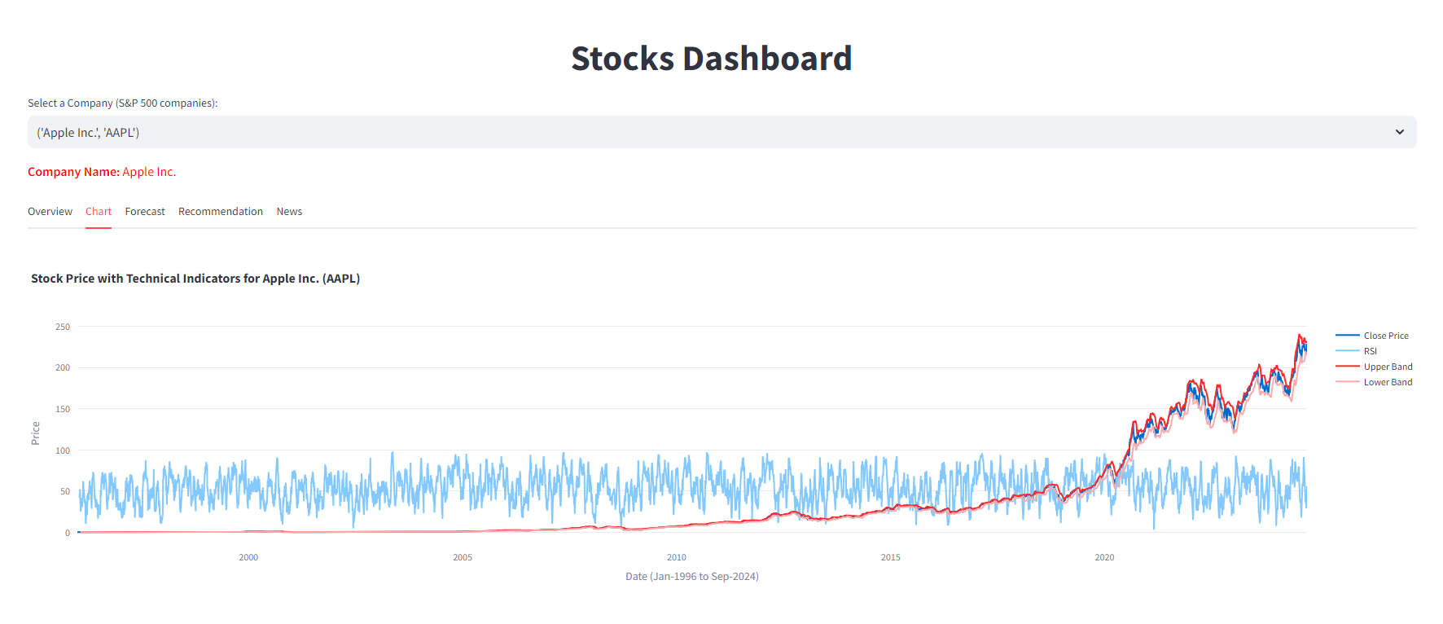
Forecast – Initial layout
Graphs with indicators such as close price, RSI, Bollinger bands & forecast

Slide 6
Demo

Slide 7
Implementation Use Cases
Portfolio Management Enhances portfolio management by benchmarking model portfolios in the advisory process.
Risk Management Forecast models can predict periods of market volatility or downturns, assisting risk managers in hedging positions.
Wealth Management Offers personalized financial advice to investors.

Slide 8
Thank you

